Slide 1
Minimizing Local Electromagnetic Interference Using Adaptive Filters
Josh Wu
Mentor: John Wallace

Slide 2
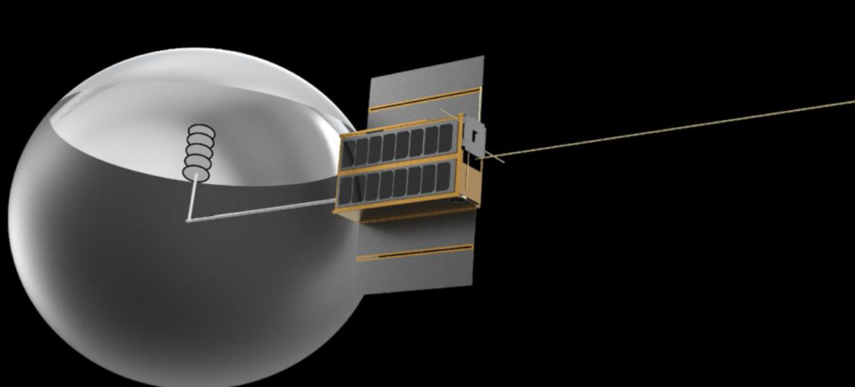
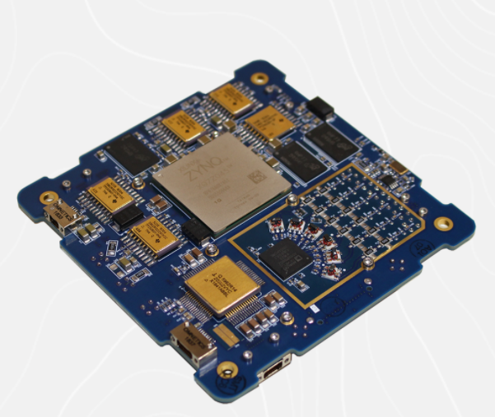
Background
Rincon Research Corporation has been working with the University of Arizona on the CatSat satellite mission.
Aboard CatSat is RRC’s AstroSDR (Software Defined Radio), most notably used for signal/image processing applications.
With the limited amount of space, close proximity of various electronics leads to interference between different parts of circuitry.

Slide 3
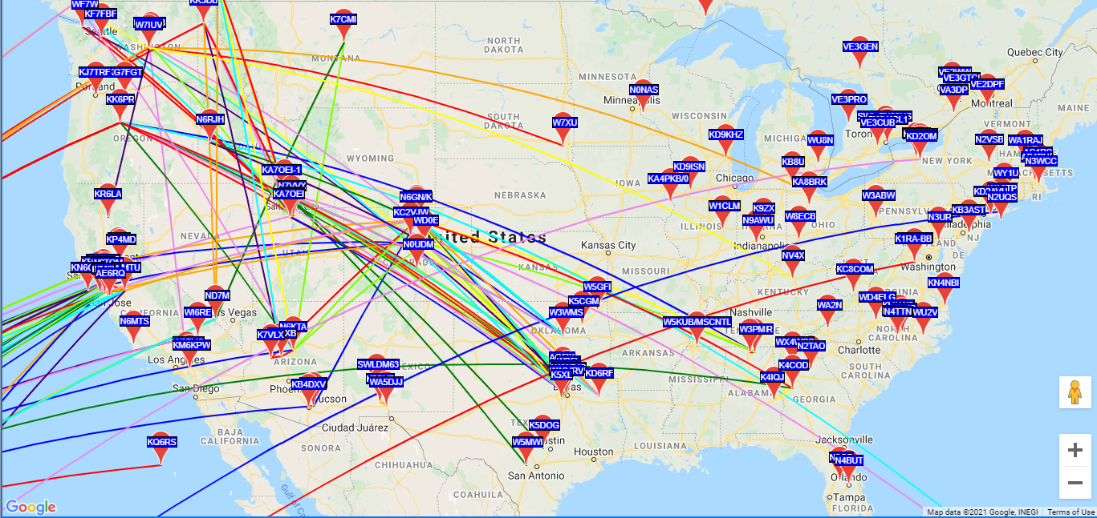
Motivation
CatSat
Record WSPR around the globe
Relay to ground
Process/Decode
Weak Signal Propagation Reporter (WSPR)
Low power, digital, radio communication protocol
Allows transmission/reception of (relatively) simple signals between users
Potentially has very low SNR
(signal-to-noise ratio)

Slide 4
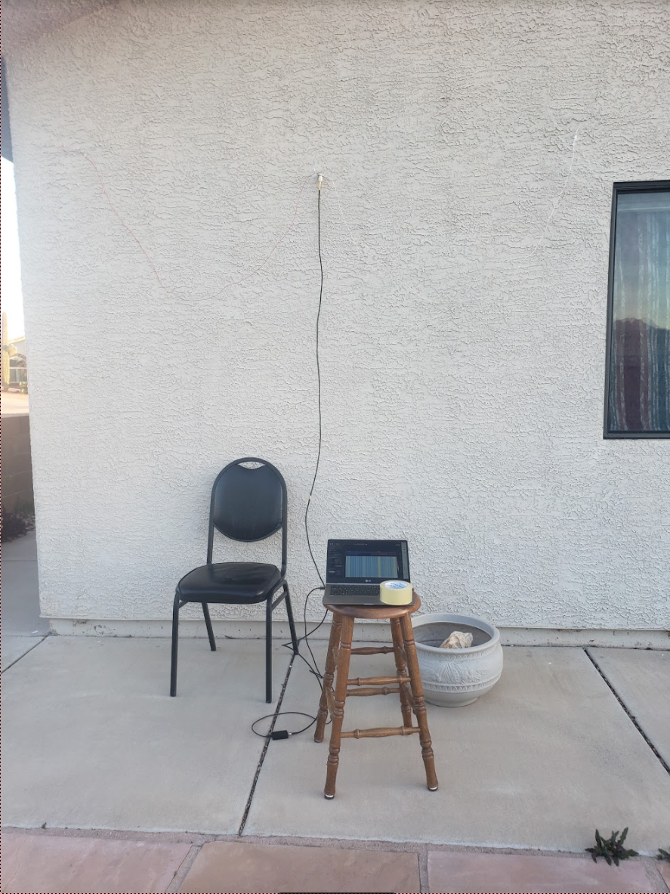
Approach
Obtain multiple signal recordings from AstroSDR
Pre-process files to ensure correct behavior
Sync up file information
Tune to correct WSPR frequency and sample rate
Feed resulting files through adaptive filter
Convert to Waveform Audio format
Observe results in WSJT-X

Slide 5
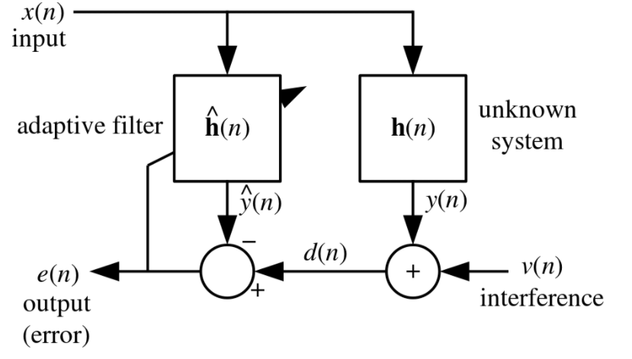
Least Mean Squares (LMS) Adaptive Filter
Based on Gradient Descent
Algorithm:
Initialize filter weights
Iteratively calculate new filter weight corrections based on current input
Converge on “optimal” weights – minimum mean square error
Chosen for its simplistic calculations

Slide 6
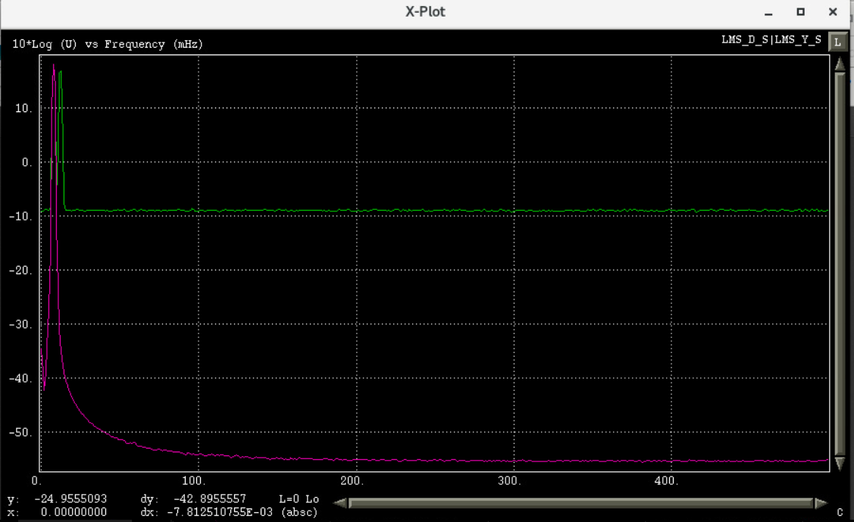
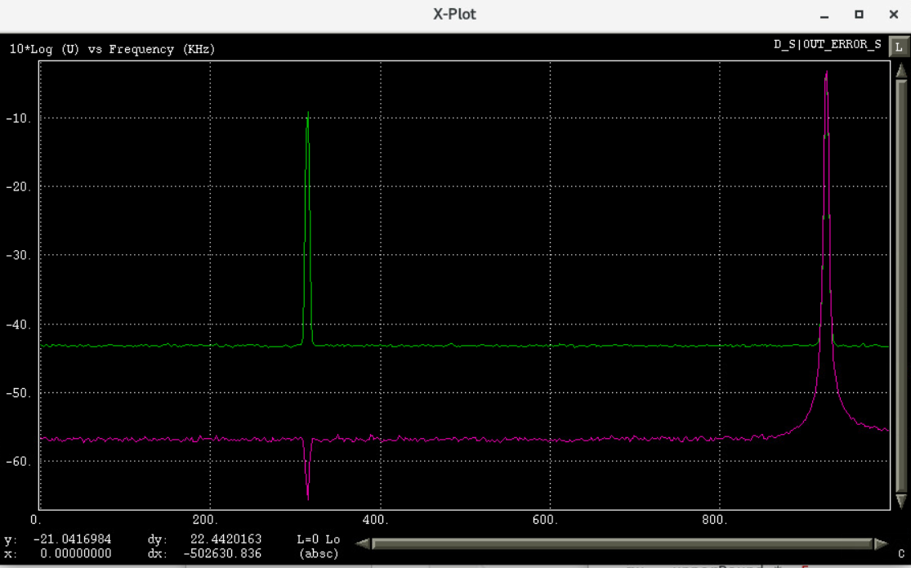
Synthetic Test Cases

Slide 7
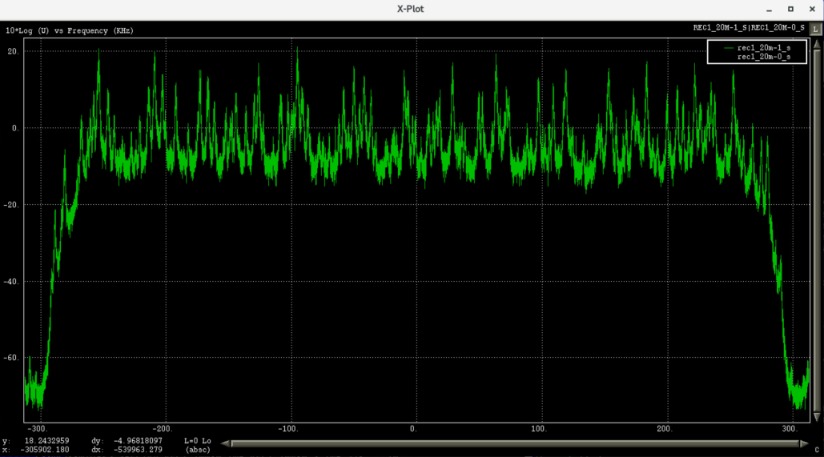
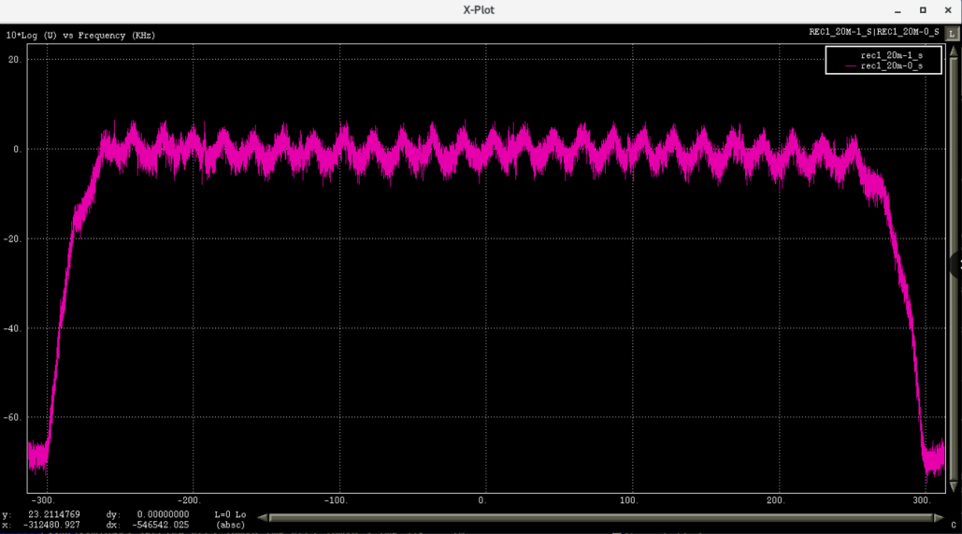
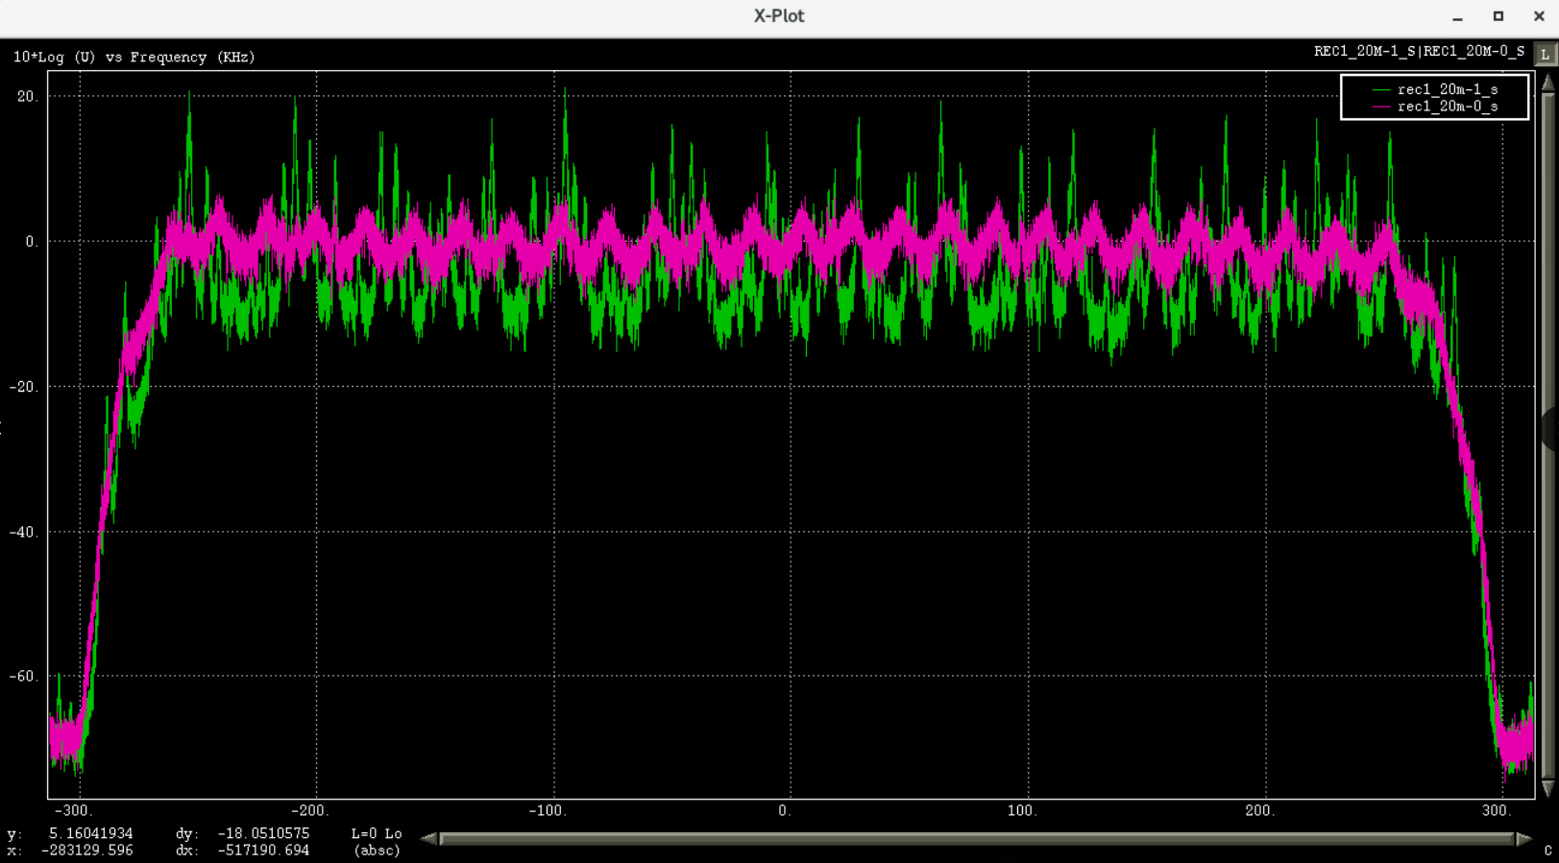
Live Recordings (March 2021)

Slide 8
Conclusion
Adaptive Filter attenuates interfering signals for artificially-created data and simulated test environments
Real-world data tests from the AstroSDR are in progress

Slide 9
Next Steps
Continue testing on real-world data
Create hardware-based (HDL) implementation for adaptive filter
Automate recording and processing procedure

Slide 10
Acknowledgements
NASA Space Grant Consortium
Rincon Research Corp.
John Wallace

Slide 11
References
CLARKSON, PETER M. OPTIMAL AND ADAPTIVE SIGNAL PROCESSING. CRC Press, 2019.

